Slide 1
Class Thirteen
Evolutionary Design

Slide 2
Overview
What's new?
Quiz
Portfolio Presentations
Autopsy
The Chapter
Lab
Attendance
Notes:
5 minutes

Slide 3
What’s New?
Next class is the last class!

Slide 4
Quiz Time
Notes:
10 minutes

Slide 5
Portfolio Presentations
No - Quiz
Yes - Autopsy
Yes - The Chapter
Yes - Portfolio Presentations
Submit your URL with Autopsy link
You will autopsy your own portfolio
5 – 15 minutes
Will present from front of room
Other students should ask questions
Notes:
20 - 30 minutes

Slide 6
Website Autopsy
Notes:
20 - 30 minutes

Slide 7
Break
Notes:
Break – 8 minutes

Slide 8
The Chapter

Slide 9

Evolution
Web constantly changing
Evolution, not revolution
Notes:
http://www.flickr.com/photos/kurdistan4all/5614565130/sizes/l/in/photostream/

Slide 10

CSS Evolves
CSS can dramatically update a website
Tweak or replace your file, new look
Different clothes, same dog
http://csszengarden.com/
Notes:
http://www.flickr.com/photos/annrkiszt/5100526558/sizes/l/in/photostream/

Slide 11
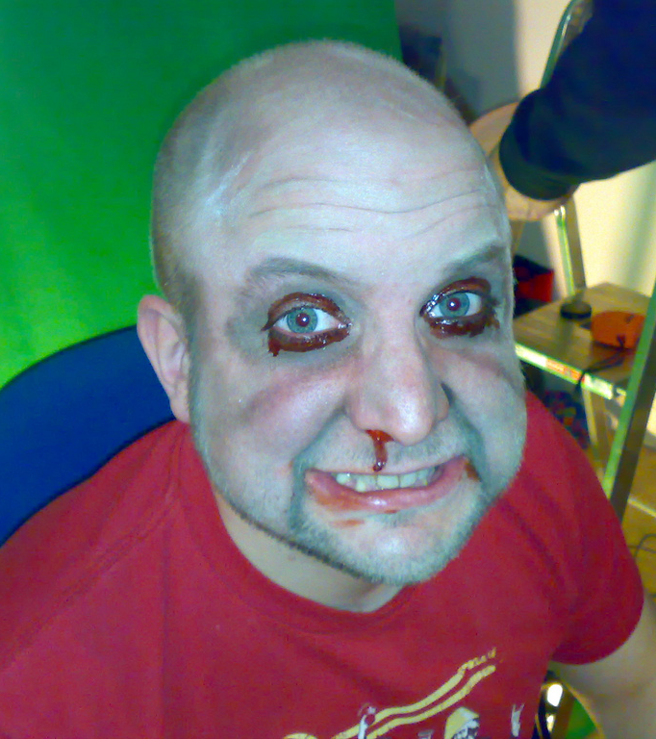
JavaScript
Doesn't have to be scary
Can use frameworks (like jQuery) to make easier
Lightbox (using Facebox)
Notes:
http://www.flickr.com/photos/clurr/2390835568/sizes/l/in/photostream/

Slide 12

WordPress
We can't add WordPress to Dropbox
Blogging engine
http://wordpress.com/
Notes:
http://www.flickr.com/photos/titanas/620861371/sizes/l/in/photostream/

Slide 13
Break
Notes:
Break – 8 minutes

Slide 14
Lab
Make the USF homepage:
http://dl.dropbox.com/u/41609448/art329/slides/classten/usiouxfallsedu.zip

Slide 15
Class Fourteen
Portfolio Presentations

